Slide 1

The future of
the Universe
Notes:
Slide notes
This presentation has been constructed using information drawn from a number of sources. The major source is Universe 101 Big Bang Theory http://map.gsfc.nasa.gov/universe/. It is highly recommended reading for physics teachers.

Slide 2
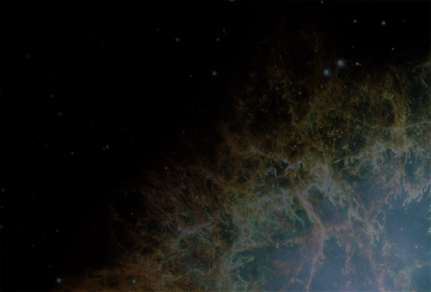
Review
What is singularity?
List three pieces of evidence for the Big Bang Theory
What three experiments are being used to collect evidence for the Big Bang Theory?
List the four fundamental interactions of the universe.
Name one type of subatomic particle created in the first moments of the Big Bang.
‘Crab nebula’ by NASA/ESA
http://en.wikipedia.org/wiki/File:Crab_Nebula.jpg

Slide 3
Learning Intentions
The universe contains features including galaxies, stars and solar systems and the Big Bang theory can be used to explain the origin of the universe
describing how the evolution of the universe, including the formation of galaxies and stars, has continued since the Big Bang
‘Crab nebula’ by NASA/ESA
http://en.wikipedia.org/wiki/File:Crab_Nebula.jpg

Slide 4
Success criteria
Briefly describe three alternative scenarios for the future of the universe.
Define critical density
Define dark matter
Define dark energy
‘Crab nebula’ by NASA/ESA
http://en.wikipedia.org/wiki/File:Crab_Nebula.jpg

Slide 5
The future of the Universe
The future of the Universe will be determined by the struggle between the momentum of its expansion and the pull of gravity.
Some say the world will end in fire,
Some say in ice.
Robert Frost (1920)
‘Crab nebula’ by NASA/ESA
http://en.wikipedia.org/wiki/File:Crab_Nebula.jpg

Slide 6
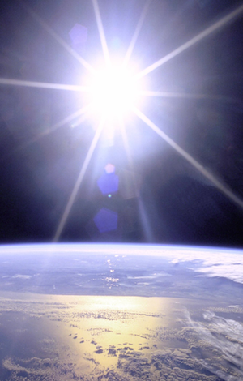
If you left your classroom and walked, climbed and swam in a straight line as far as possible, where would you end up?
After about 40 000 km, you would return to your starting place because the surface of the Earth is curved.
‘Sunburst over Earth’ by NASA
http://commons.wikimedia.org/wiki/File:Full_Sunburst_over_Earth.JPG

Slide 7
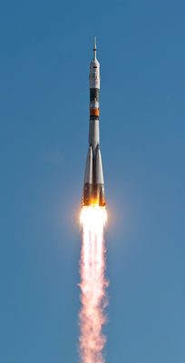
If you left Earth and travelled in a straight line as far as possible, where would you end up?
Cosmologists aren't sure.
Some believe you can travel an infinite distance; others think you would end up back where you started.
It depends on the shape
of the Universe.
Soyuz TMA-18 launch
http://commons.wikimedia.org/wiki/File:Soyuz_TMA-18_launching.jpg

Slide 8
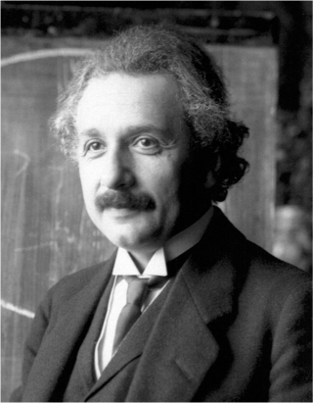
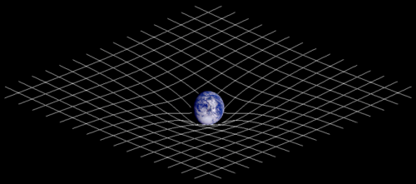
Curvature of space
In the theory of general relativity, Einstein proposed that mass distorts spacetime.
Is the mass of the Universe enough to distort spacetime and make it close in on itself, like the surface of a sphere?
Or will gravity stop the Universe expanding?
Notes:
Slide notes
The Cosmological Principle tells us that the Universe has uniform composition and density in all directions. General relativity can therefore be used to compute the effects of gravity on that matter. Since gravity is a property of spacetime, this is equivalent to computing the dynamics of spacetime itself.

Slide 9
Predicting the future of the Universe
The future of the Universe depends on the density of matter and the effect of gravity on it.
So if we know its density we should be able to predict the shape and future of the Universe.
Our predictions are based on two major assumptions:
  the laws of physics are the same everywhere in the Universe, and
  the part of the Universe that we can see is typical of the whole Universe.
Notes:
Slide notes
The two assumptions are derived from the Cosmological Principle, which can be stated as
Viewed on a sufficiently large scale, the properties of the Universe are the same for all observers.

Slide 10
Critical density
Critical density is the average density of matter required for the Universe to just halt its expansion
- but only after an infinite time.
The critical density of the Universe is about 10⁻²⁶ kg m⁻³ (approximately equal to 6 hydrogen atoms per cubic metre).
This amazingly low value is more than ten million times lower than the density of the best vacuum ever achieved on Earth.

Slide 11
The future of the Universe
There are three possible scenarios depending on how the density of the Universe compares to its critical density.
The future of the Universe will be determined by the balance of its Big Bang expansion and the effect of gravity on its mass.
Predict the outcome if the Universe is …
  more dense than critical density …
  less dense than critical density …
  equal to critical density …
Notes:
Teaching/discussion point
This is a useful place to involve students in discussion about the balance between Big Bang expansion and the effects of gravity on matter. In small groups, students could be encouraged to speculate on the future of the Universe if gravity is too strong, too weak or just right.
Answers
If the density of the Universe is greater than critical density, gravity will eventually stop its expansion and then reverse it. The Universe will eventually collapse back in on itself and end in the ‘Big Crunch’.
If the density of the Universe is less than critical density, the Universe will continue to expand forever. Eventually it will cool down and end in the ‘Big Chill’.
If the density of the Universe equals critical density it will continue to expand at an ever-decreasing rate. Gravity will eventually stop its expansion, but only when infinite time has passed.
The problem for cosmologists attempting to predict the Universe’s future is that its density hasn’t been determined.

Slide 12
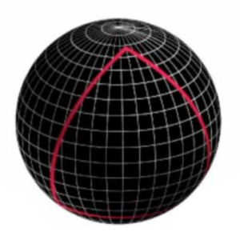
Scenario 1: closed Universe
If the density of the Universe is greater than critical density:
    gravity will be strong enough to stop its expansion and reverse it; and
    the Universe (spacetime) may be thought of as closed, like the surface of a sphere.
Notes:
Slide notes
The key idea in the following three scenarios is that there is a direct link between the geometry of the Universe and its likely future.
The image shows gravity distorting the geometry of spacetime and giving it a curvature like the surface of a sphere.
In a closed Universe:
• a space traveller could start a journey in one direction and, if allowed sufficient time, ultimately return to his/her starting point.
• the sum of the angles of a triangle exceeds 180 degrees and there are no parallel lines; all lines eventually meet.

Slide 13
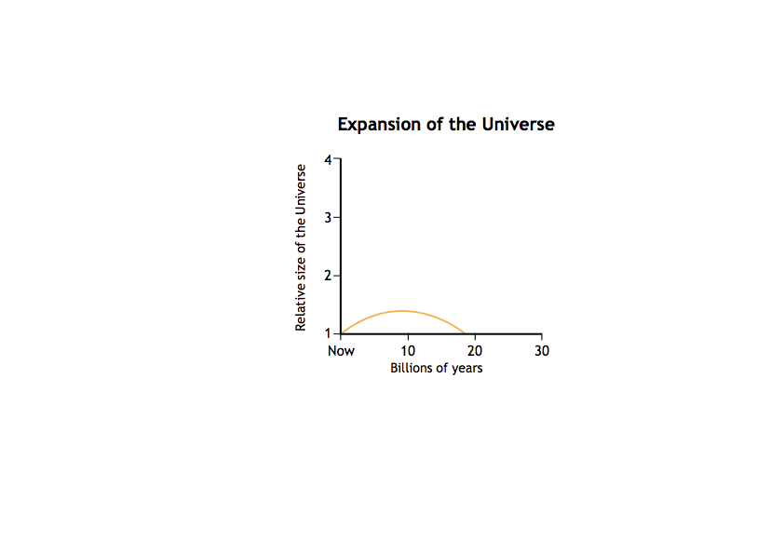
Future of a closed Universe
Eventually, gravity will cause a closed Universe to collapse back in on itself, ending in the 'Big Crunch'.
The orange curve represents the evolution of a closed Universe.
closed
Notes:
Slide notes
A closed, high density Universe will expand for several billion years then ultimately contract and collapse under its own weight.

Slide 14
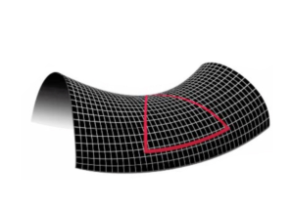
Scenario 2: open Universe
If the density of the Universe is less than critical density:
gravity will be too weak to stop its expansion;
the Universe will continue to expand forever at an ever-decreasing rate; and
the Universe (spacetime) can be thought of as being curved like the surface of a saddle.
Notes:
Slide notes
The image shows the geometry of spacetime with a curvature similar to the surface of a saddle.
In an open Universe:
• a space traveller starting a journey in one direction would never return to his/her starting point.
• the angles of a triangle sum to less than 180 degrees and lines that don’t meet are never equidistant; they have a point of least distance but otherwise grow apart.
The geometry of an open Universe is said to be hyperbolic.

Slide 15
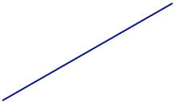
The future of an open Universe
As the Universe continues to expand, all stars and galaxies will exhaust their energy.
The Universe will cool down, ending in the 'Big Chill'.
The blue curve represents the evolution of an open Universe.
open
closed
Notes:
Slide notes
An open, low density Universe will expand at an ever-decreasing rate. However, its expansion will occur at a faster rate than for a flat Universe (see next slides) because the effect of gravity is not as strong.

Slide 16
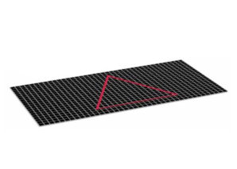
Scenario 3: flat Universe
If the density of the Universe is equal to critical density:
gravity is just sufficient to stop its expansion – but only after an infinite time; and
the Universe (spacetime) can be thought of as being flat.
Notes:
Slide notes
If the density of the Universe is equal to critical density, the geometry of spacetime will be flat.
In a flat Universe:
• a space traveller starting a journey in one direction would never return to his/her starting point.
• the sum of the angles of a triangle is 180 degrees and parallel lines continuously maintain the same distance apart.

Slide 17

The future of a flat Universe
A flat Universe will also continue to expand at an ever-decreasing rate (but slower than an open Universe).
The green curve represents the evolution of a flat Universe.
Most cosmologists favour this as the predicted future of the Universe.
open
flat
closed
Notes:
Slide notes
A flat, critical density Universe will continue to expand at an ever-decreasing rate. However, its rate of expansion will be less than that of an open Universe.

Slide 18
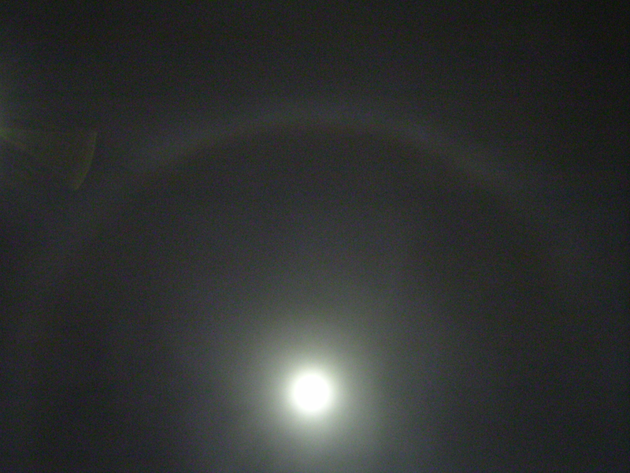
Which prediction is most likely?
To make a reliable prediction about the shape and future of the Universe, cosmologists need to know its density.
To do this, they need to know what the Universe is made of.
They knew that it contained matter and radiation, but that wasn’t all...

Slide 19

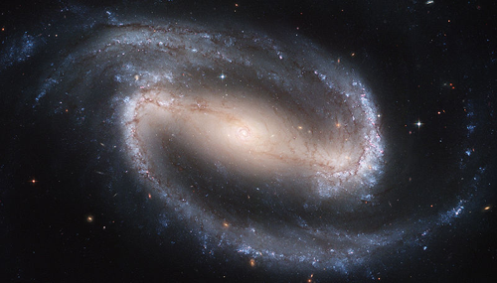
The missing mass problem
In 1933, astronomer Fritz Zwicky studied the motions of galaxies near the outer edges of distant galaxy clusters.
He found they were rotating too fast for the visible mass of the cluster to stop them from flying away.
He deduced that the cluster must have more mass, but it wasn't visible matter.
Scientists now estimate that there is at least 4-5 times as much invisible matter as there is visible.
Notes:
Slide notes
Prior to Zwicky’s discovery, astronomers believed that the Universe was dominated by visible matter - protons, neutrons and electrons.
Within a galaxy, astrophysicists can measure the rate of rotation of stars around the galactic centre. They observed that outer stars rotated too fast to be held in place by gravity from the amount of matter they could see in the galaxy. They estimated that about 4-5 times more matter is needed to explain the observation.
In addition, the motion of galaxies within a cluster suggested that they are bound by a total gravitational force due to 5-10 times as much matter as could be seen within them.
Astrophysicists explained these results by proposing that every galaxy is surrounded by a halo of dark matter.
Teaching point
In Physics unit 3APHY, students should understand the relationship between gravitational and centripetal forces and how the orbital velocity of a satellite relates to the mass of the object it orbits. This knowledge could be applied to enable them to understand Zwicky‘s findings.

Slide 20
Dark matter
By the 1970s, cosmologists began to realise that only large amounts of Zwicky's 'missing mass' could explain many of their observations.
We now call the missing mass dark matter.
Scientists are searching for dark matter to explain the motion of galaxies and to inform current theories about the origin and the future of the Universe.
Notes:
Slide notes
Since Zwicky’s discovery, astronomers began to recognise that dark matter dominated the Universe.
Dark matter:
was inferred from effects of gravity on visible matter and background radiation (gravitational lensing);
has never been observed directly; and
could possibly include massive neutrinos, WIMPS (weakly interacting massive particles) or MACHOS (massive astrophysical compact halo objects).
Who says physicists don’t have a sense of humour?

Slide 21
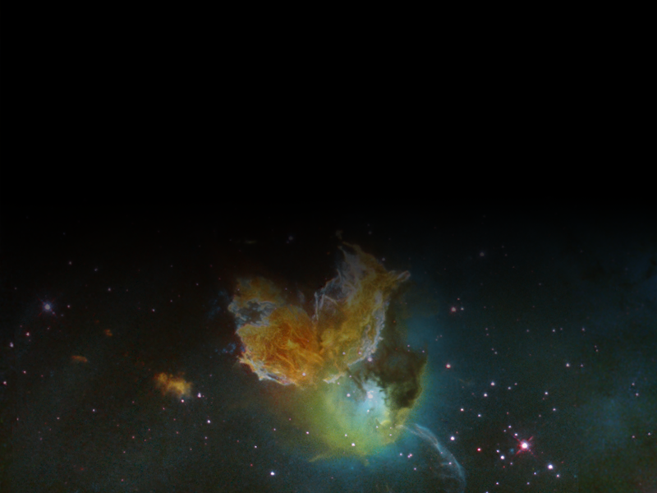
Dark energy
In the 1990s, astronomers found evidence that the Universe is expanding at an accelerating rate.
To explain this, they introduced the idea of dark energy.
Hubble Space Telescope image of supernova remnant N 63A.
NASA/ESA/HEIC, http://en.wikipedia.org/wiki/File:STScl-2005-15.png
Notes:
Slide notes
In the 1990s, astronomers observing distant supernovae found evidence that the Universe is expanding at an increasing rate. They discovered that the acceleration of more distant galaxies is less than that of galaxies closer to Earth (i.e. younger galaxies). From this, they inferred that the Universe is expanding at an accelerating rate. This inevitably led to ask what was causing this increasing expansion?
Slides 18-20 introduce the concept of dark energy as the likely explanation.

Slide 22
Dark energy
Unlike gravity, which slows the expansion of the Universe, dark energy speeds it up.
Dark energy is thought to have a gravitationally repulsive effect on matter.
Dark energy will make the Universe expand exponentially forever, and its effects appear to increase as the Universe expands.
Dark energy accounts for 72% of the mass of the Universe, but cosmologists are not agreed on what it really is.

Slide 23

Total mass-energy of the Universe
Cosmologists now believe that the composition of the Universe is:
dark matter 23%
dark energy 72%
atoms 5%
TODAY

Slide 24
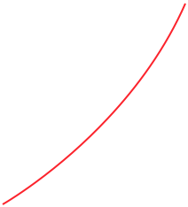
Scenario 4
If the Universe is expanding at an accelerating rate (the red curve on the graph):
The galaxies we now see will recede out of sight, one by one.
Billions of years from now, the Milky Way will be the only galaxy in sight.
Our Sun will have shrunk to a white dwarf star that will provide little light and heat to Earth.
Stars will burn out and collapse into black holes and the Universe will end up as a vast, empty, dark and cold place.
Notes:
Slide notes
The red curve shows a Universe in which a large proportion of matter in the form of dark energy is causing its expansion to speed up.
There is growing evidence that our Universe is following the red curve.

Slide 25



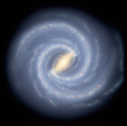


Milky Way

Slide 26
Success criteria
Briefly describe three alternative scenarios for the future of the universe.
Define critical density
Define dark matter
Define dark energy
‘Crab nebula’ by NASA/ESA
http://en.wikipedia.org/wiki/File:Crab_Nebula.jpg

Slide 27
© 2011 The University of Western Australia
ast0708, v1.0
for conditions of use see spice.wa.edu.au/usage

